Slide 1
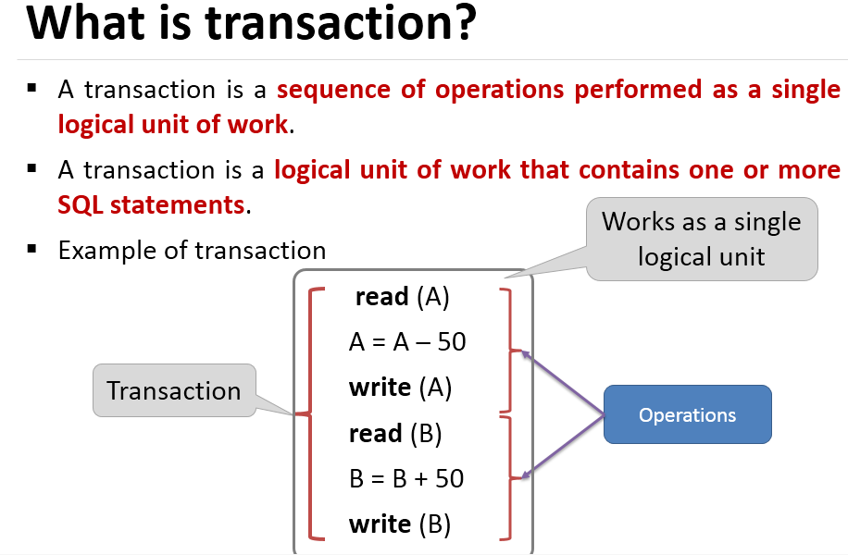

Slide 2
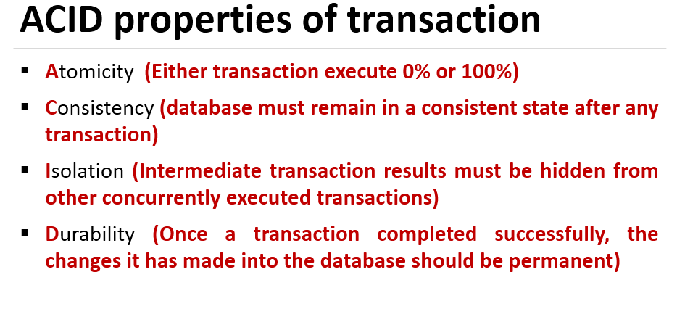

Slide 3
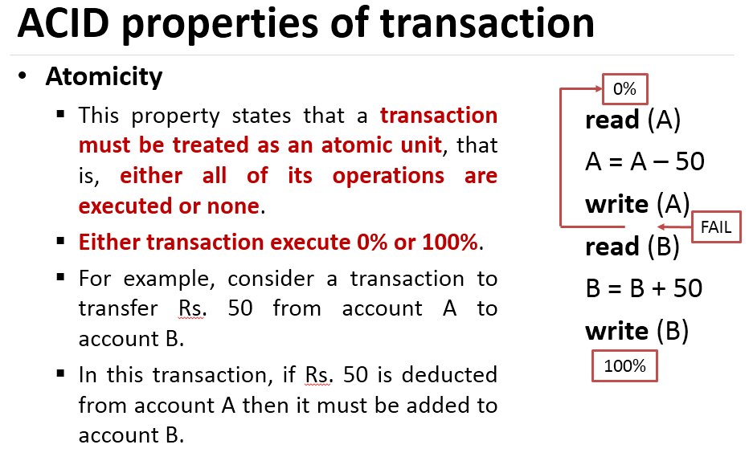

Slide 4
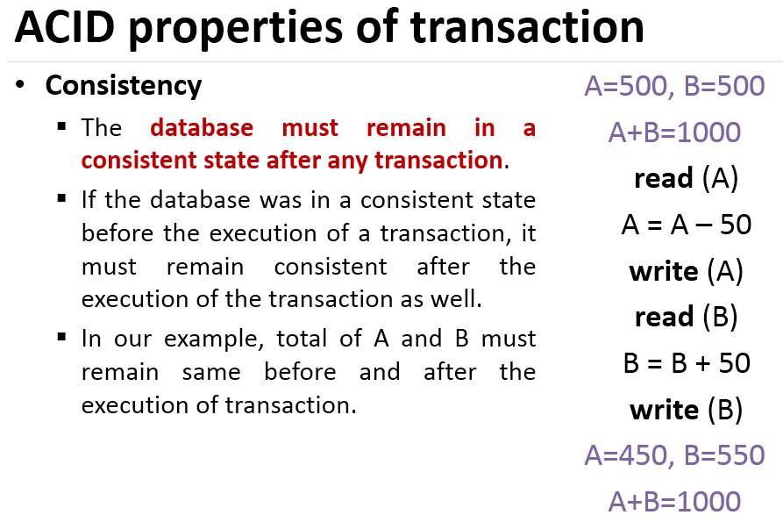

Slide 5
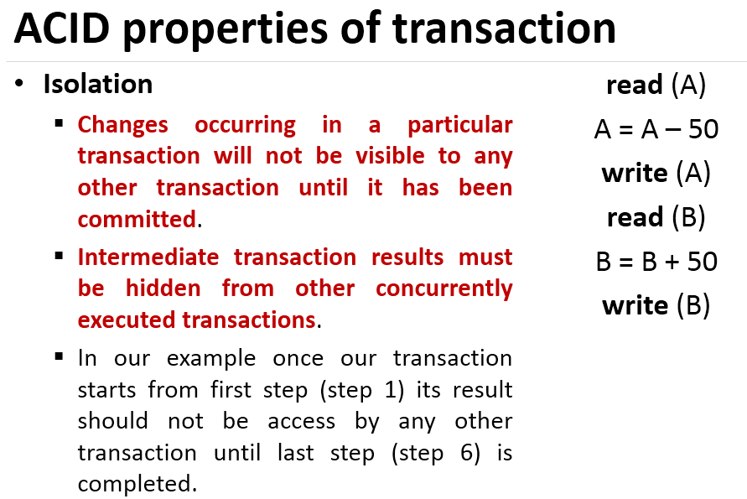

Slide 6
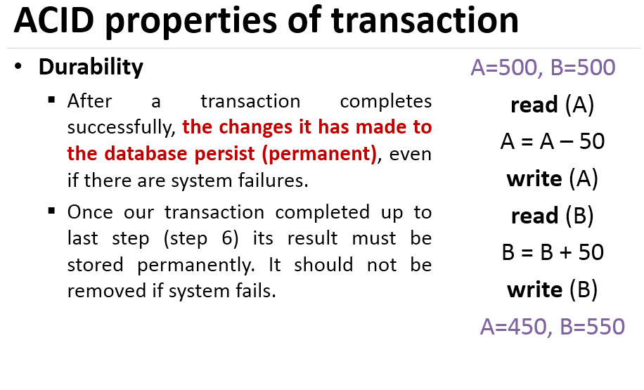

Slide 7
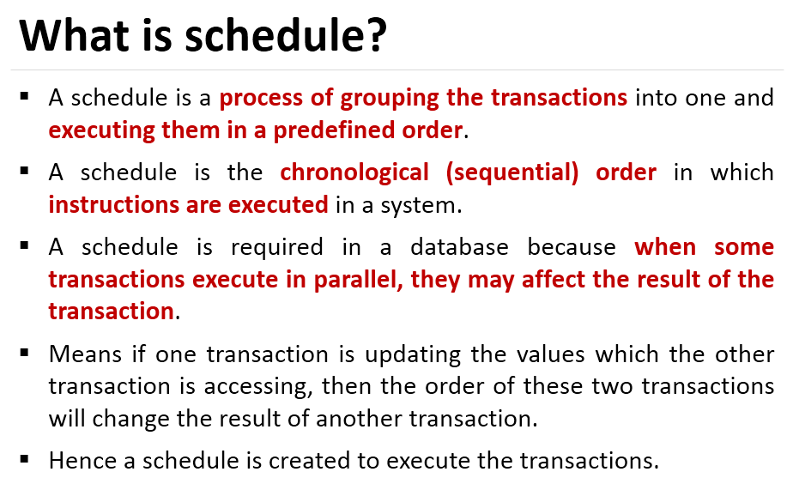

Slide 8
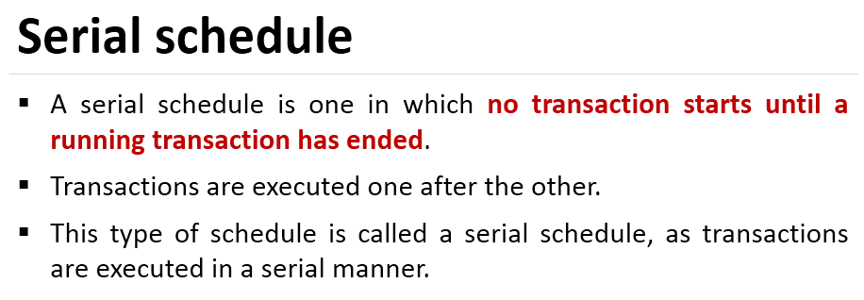

Slide 9
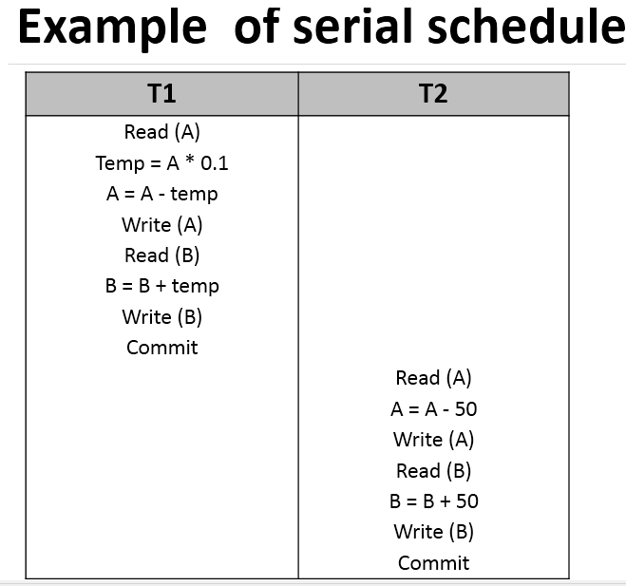

Slide 10
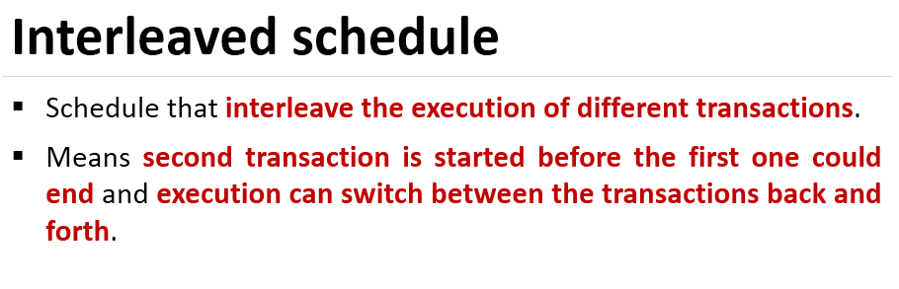

Slide 11
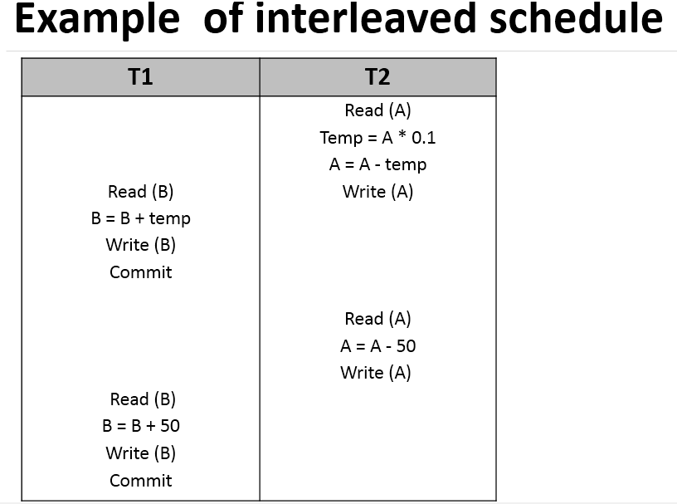

Slide 12
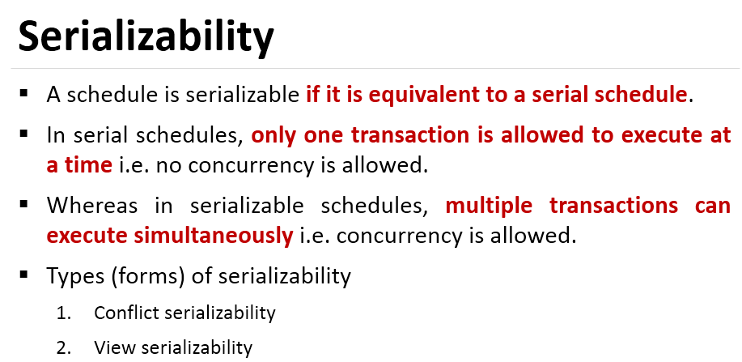

Slide 13
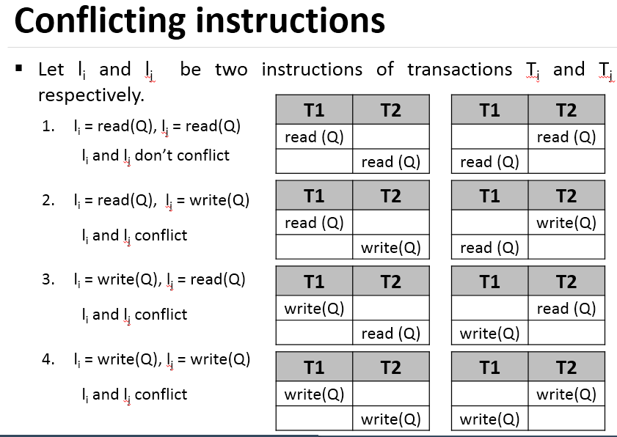

Slide 14
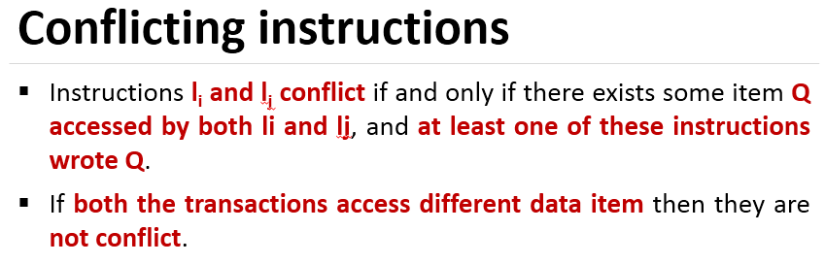
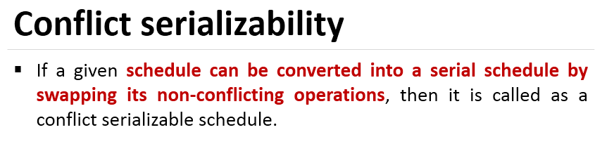

Slide 15
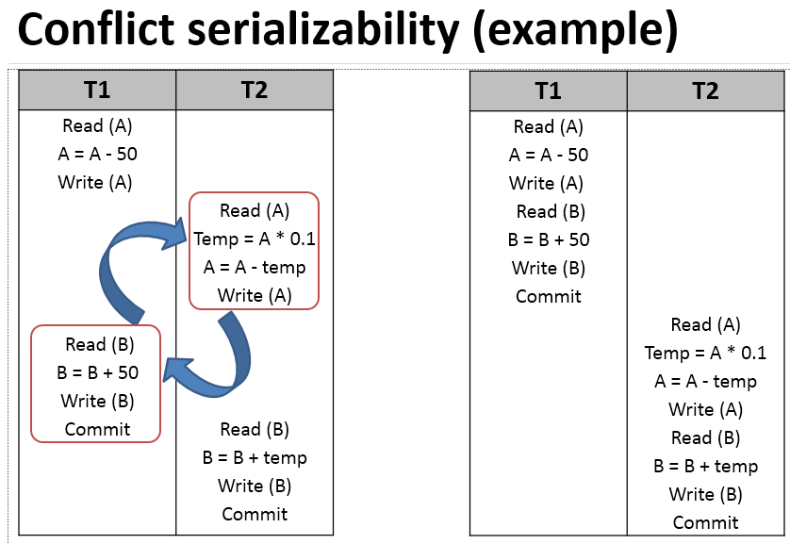

Slide 16
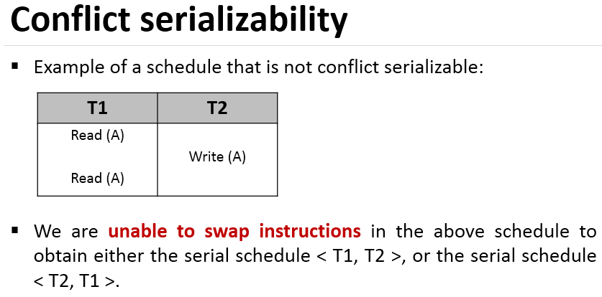

Slide 17
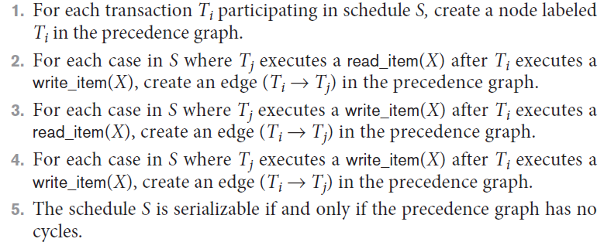
Characterizing Schedules Based on Serializability (cont’d.)
Testing for serializability of a schedule

Slide 18
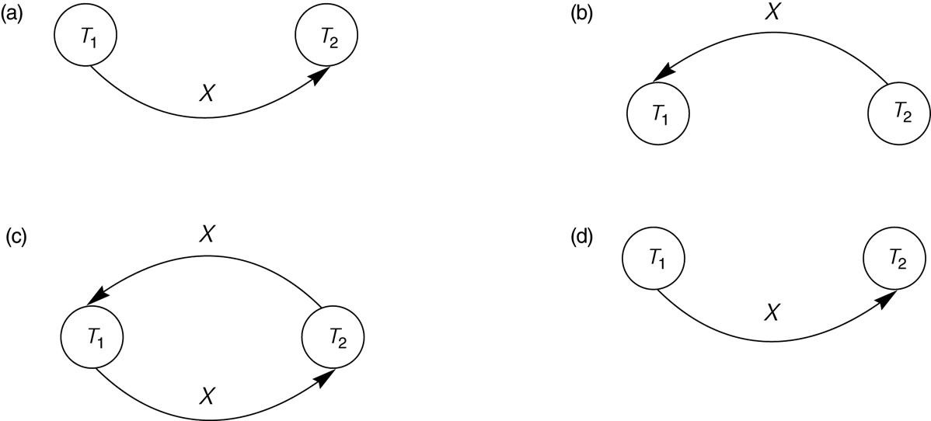
Constructing the Precedence Graphs
FIGURE 17.7 Constructing the precedence graphs for schedules A and D from Figure 17.5 to test for conflict serializability.
(a) Precedence graph for serial schedule A.
(b) Precedence graph for serial schedule B.
(c) Precedence graph for schedule C (not serializable).
(d) Precedence graph for schedule D (serializable, equivalent to schedule A).

Slide 19
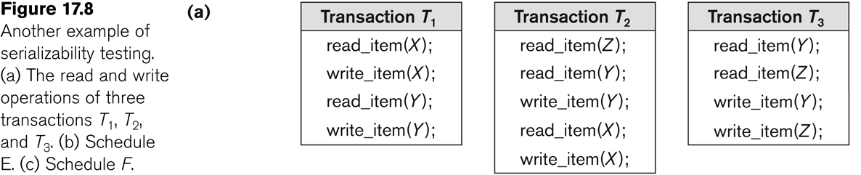
Another example of serializability Testing

Slide 20
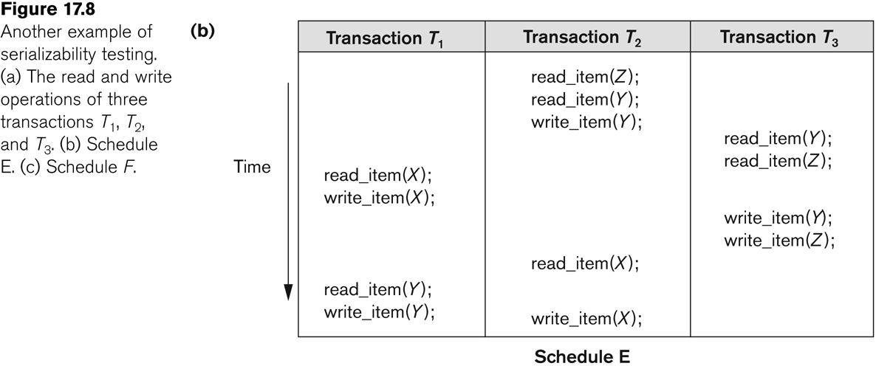
Another Example of Serializability Testing

Slide 21
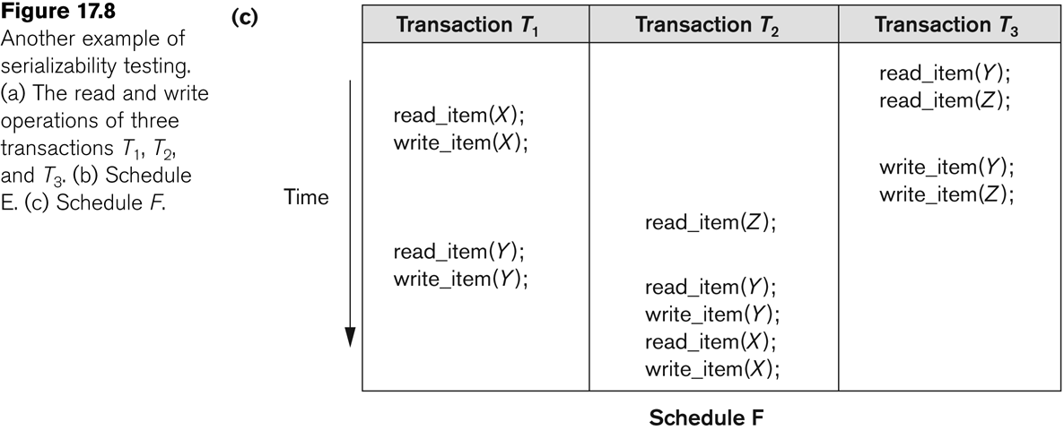
Another Example of Serializability Testing

Slide 22
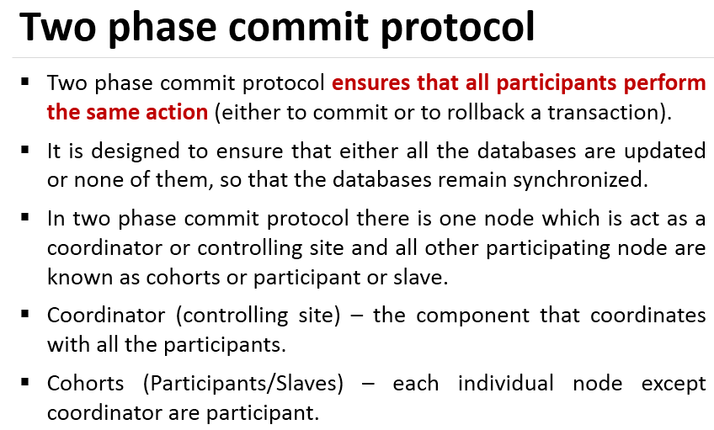

Slide 23
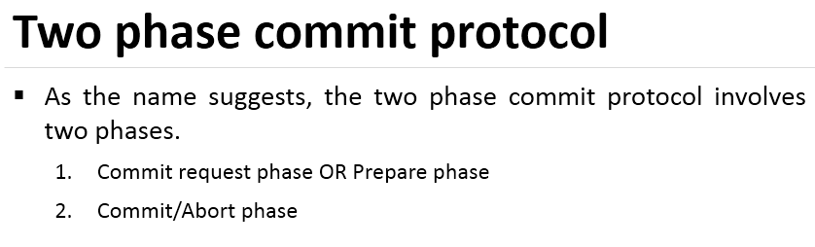

Slide 24
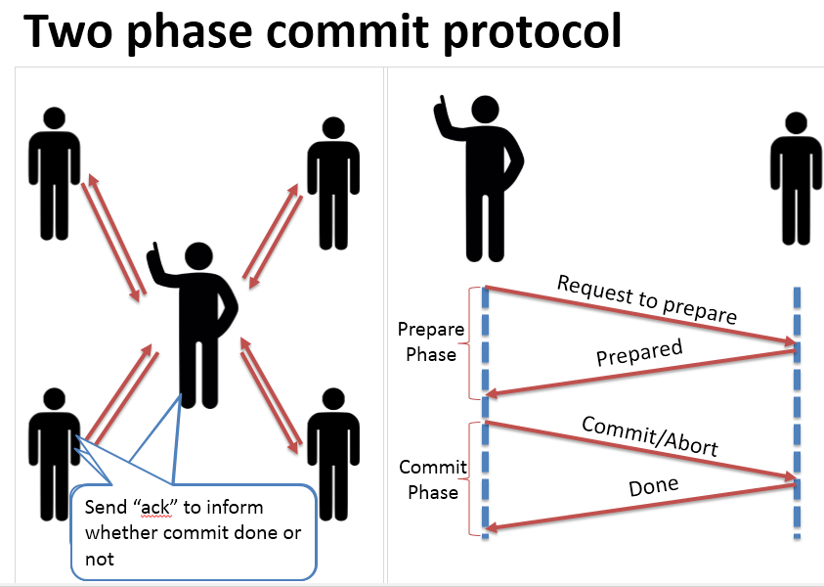

Slide 25
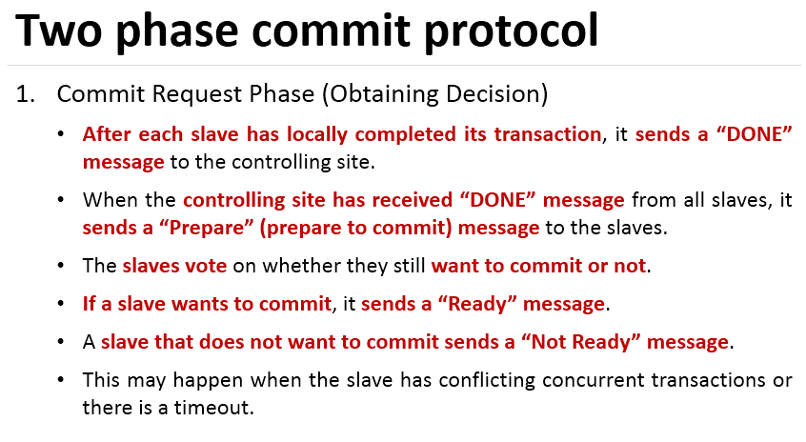

Slide 26
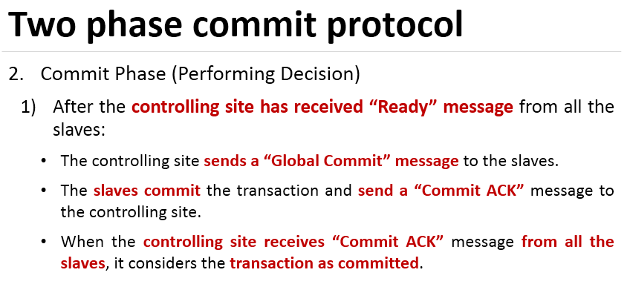

Slide 27
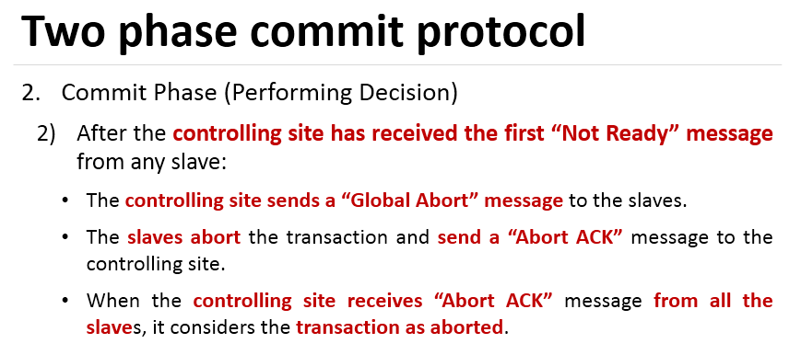

Slide 28
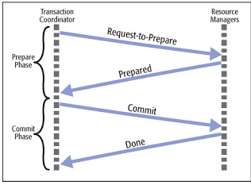
Two phase commit protocol
Atomic commitment protocol
Distributed algorithm that coordinates all process and participate in a distributed atomic transaction, whether to commit or abort T

Slide 29
Limitation
Block Problem:
- Blocking reduces the availability of system since blocked transactions keep all the resources until they receive final command from coordinator.

Slide 30
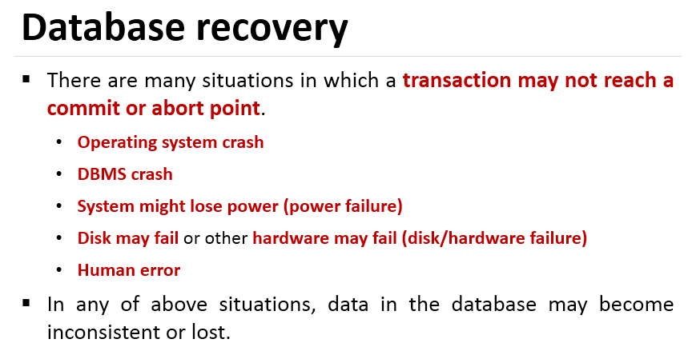

Slide 31
